Slide 1
Caption/Cutline Activity
For each of the five images, create a caption that conveys something of the story you imagine is involved in the photo. After you are finished, upload to your blog.

Slide 2
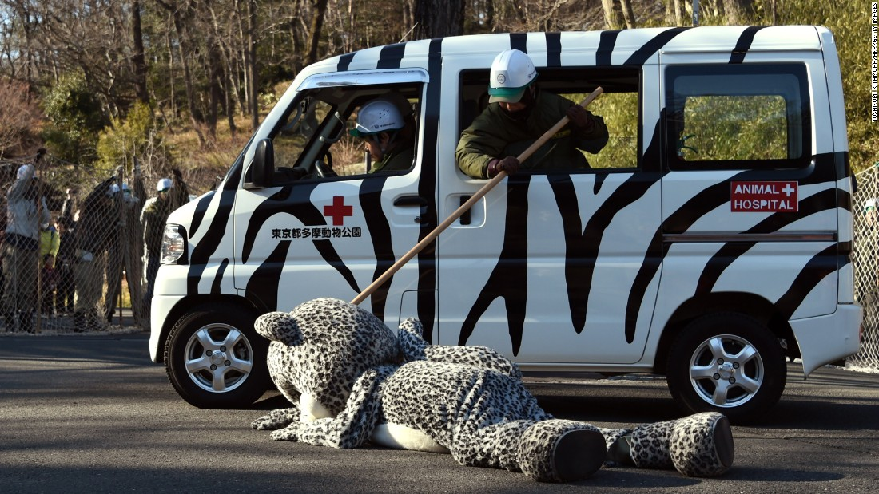

Slide 3
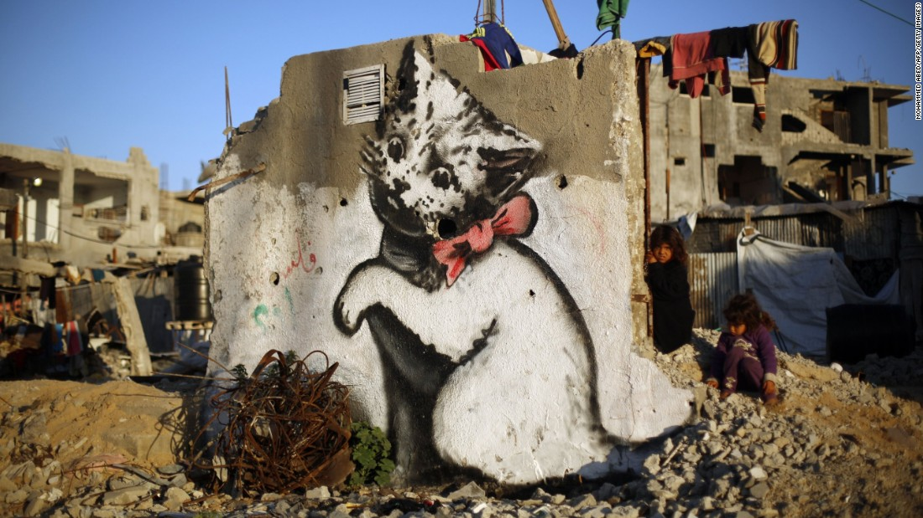

Slide 4
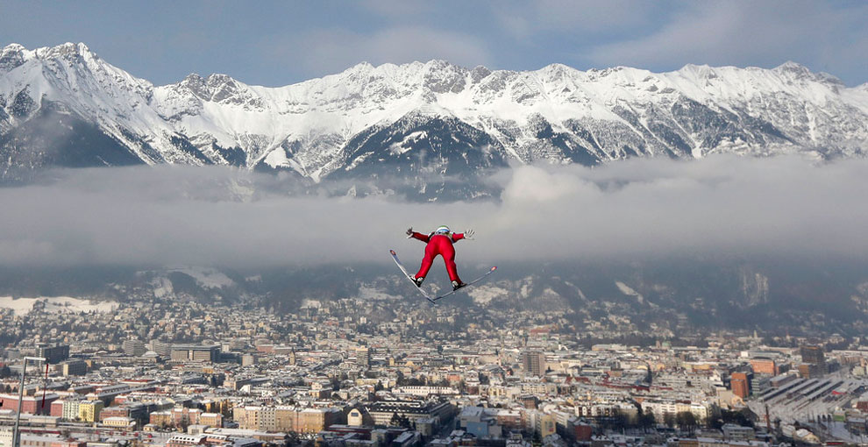

Slide 5
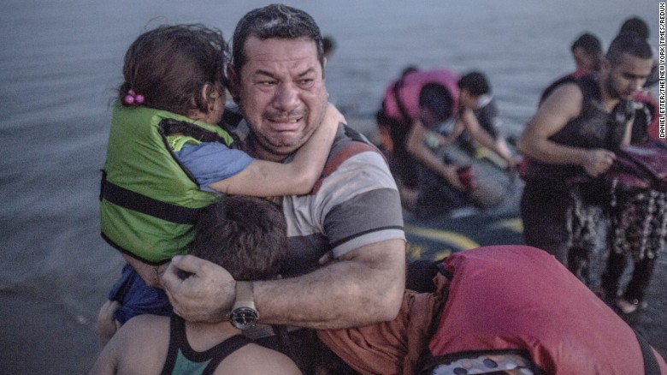

Slide 6
